Slide 1
Virtual Reality
Kipchakpayev Madiyar IS-1812k

Slide 2
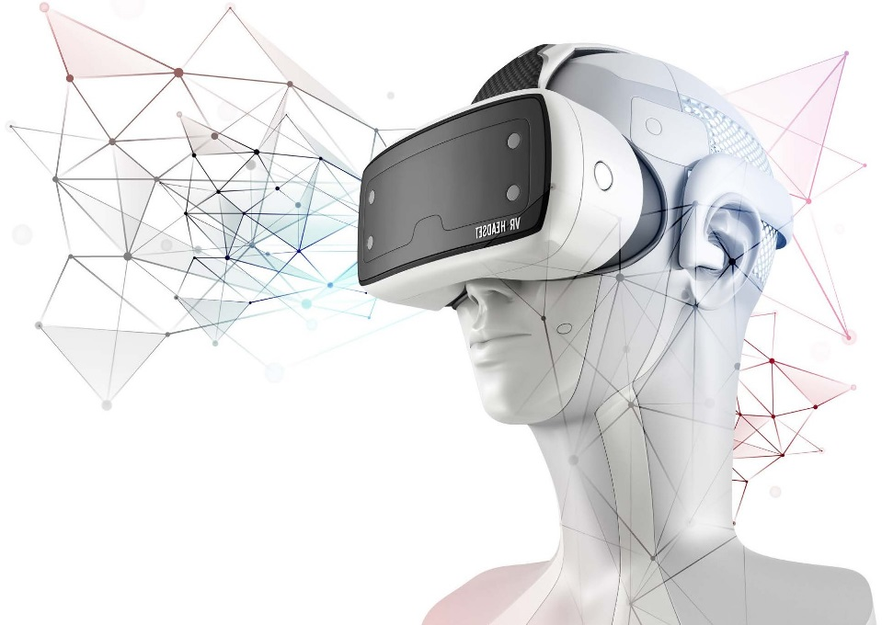
Introduction
The Digital space around us has changed significantly in the last decade or so, and the amount of time we all spend around digital gadgets is far more than anybody would have ever imagined. The millennial generation that is growing up in this Digital era accepts this as their natural environment and part of the usual routine. Most of us are now quite familiar with internet usage – browsing, shopping, watching a movie, communicating with friends/family. However, even though this is still a virtual environment created in the Digital ecosystem, we have accepted it as a reality and part of our daily routines and lives. Just imagine a day without internet and mobile phones – though not IMPOSSIBLE, it is not VIABLE either.

Slide 3
Application and Adaptions Verticals
Augmented Reality and Virtual Reality has been evolving over the years as a new means of visual communication and interface. It broadens the horizon of our interaction with the Digital environment and moves away from the 2-D interface of the screen. It is visually possible to create our own visual environment by augmenting the surrounding using the phone, camera, glasses etc., which it does not exist.

Slide 4
Market Overview
$3.5 Billion
Financial Backing
The approximate value of venture capital investment made since 2016. Facebook paid $2bn to acquire Oculus in 2014
2 Million
Shipping Out
The number of Google Cardboard
head-mounted displays distributed since the product’s June 2014 launch
150 Million
VR Users
In 2014, there were less than one million VR users, but that number has incredibly grown to more than 150 million users this year
$26.4 Billion
Market Valuation
The market was $2B in 2016 and is expected to rise to $26.4 Billion by 2022
48 Hours
Selling Out
The amount of time it took for Samsung
$99 Gear VR o sell out on Amazon.com and BestBuy.com – an indication of strong demand at lower price points.
60/40 Ratio
Hardware/Software Revenue
Out of the total project revenue, Hardware is expected to generate 57% revenue while Software will generate the remaining 44%.
800+
Companies
Are currently engaged in the Augmented Reality and Virtual Reality segment worldwide.
200K
Developers
The number of developers registered for Oculus to create games on the VR platform.
121 Countries
Global Interest
The number of countries represented in the viewership data for the first US Democratic presidential debate, which CNN streamed in VR.

Slide 5

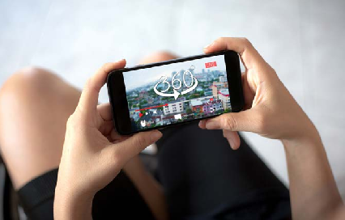
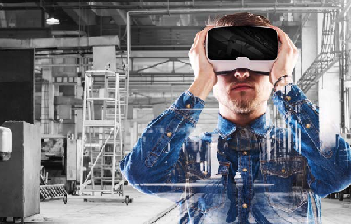
Video Games
360 Video and Live Events
Virtual Reality games are being one of the primary application of AR and VR currently. It provides a virtual experience in a three-dimensional interactive environment to play a game.
Rendering a 360-degree video an event, to watch globally or locally resulting in a much more immersive experience
Design, Architecture Engineering & Construction (AEC), Commercial Real Estate (CRE)
Virtual Reality, 3D Animation and Augmented Reality are being used in Design, AEC, and Commercial Real Estate to provide architectural visualization, design reviews and approval before the actual construction begins.

Slide 6
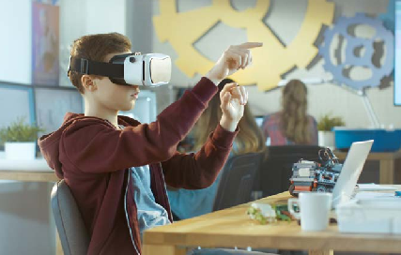
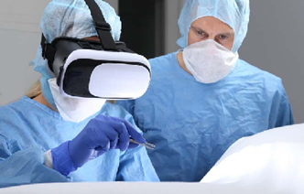
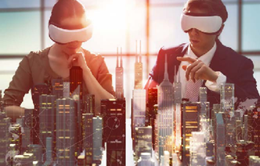
Next Phase Usage
Education and Training
Apart from the gaming adoption, VR and AR have been adopted at a faster pace in the Education and Training sector primarily in Aviation, Flight Training, Healthcare, Military Training, and Engineering.
Diagnostics
With an Augmented Reality, remote diagnostics, where a person would be able to visually see, interact and collaborate to solve a problem, provide a solution and recommendations.
This is primarily being envisioned in the Medical/Healthcare field where a doctor could translate CT and MRI scans into interactive 3D models and virtually perform the procedure and plan ahead of time.
Collaborative Virtual Environment (CVE)
A collaborative work environment is the futurist thought process of how people will have a working environment to interact, change, and amend the data within the virtual environment.
A collaborative working environment could be entirely digital, or mixed with the digital and real world.

Slide 7
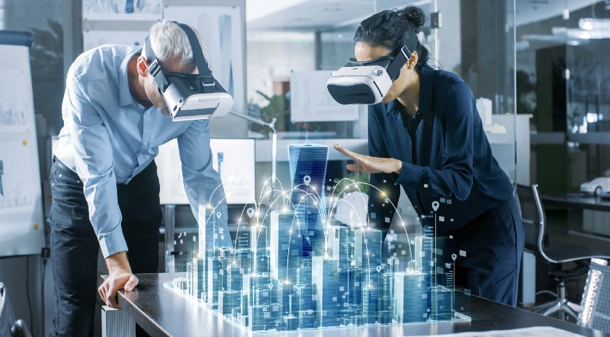
Examples of AR/VR Applications
Healthcare
VR has been effectively used in the healthcare for a year. It provides the doctor with a controlled environment to perform and study the health issue.
In 2016, a doctor in Miami used Google Cardboard to plan a survey on a baby who was born with one lung. The cardboard was used to create a 3D image of the baby heart.
Sports
Virtual reality in sports is being widely adopted across the industry for a variety of training, live streaming service etc.
Major Baseball and Football Leagues are using VR to train umpires and referees.
NextVR has a contract with Fox Sports as the exclusive virtual reality broadcaster for all events covered by the network.
Automobile
VR is used for creating the car design and driving simulators
The London Audi City showroom in Green Park, is the smallest Audi dealership in
the UK, measuring 420 Square Meter and featuring 4 models. 50% of the customer ordered vehicle at the store without a physical test drive.
Tourism
VR is helping consumers make a decision about where to travel and also experience what they could expect. The apps will help convey the intensity and emotions of the travel experience before the journey begin.
Thomas Cook partnered with Samsung and Virtual filmmaker Visualise to create a series of short films in several destinations.
Marriott is testing VRoom service – a first- of-its-kind guest service that allows guest to order inspiring virtual reality experience to their rooms.
Real Estate
VR allows the customer and 3D and
360-degree view of the of the real-estate
house, building, apartment etc. and enhance the real-estate sales.
Sotheby's International Realty has begun experiencing with Samsung Gear VR as
a new showcase for multi-million-dollar homes based in Los Angles, New York

Slide 8
Key Challenges for AR/ VR Adoption
The year 2016 is the key year for AR/VR platform as people started to take notice of this new technology.
• Facebook bought Oculus in 2016 for $2B
• Microsoft released their Augmented Reality product HoloLens on 30th March 2016.
Over the past couple of years, there has been tremendous discussions, events, and prototypes launched around the technology. AR/VR is the prime attraction at the Consumer Electronics Show (CES) and at the Virtual Reality, Los Angles (VRLA) conference/expos, where companies demonstrate the various prototypes and use cases of this technology. But the reality is that it is far from the main-stream mass adoption at this point in time. Like all the major technology adoption, AR and VR have
currently hit the gap-of-disappointment where the evolution in technology is trying to overcome the key challenges before it comes mainstream and ready for mass adoption. Secondly, most of the use-cases or prototypes are visually very appealing, but the practical usage remains low.
Some of the key challenges or roadblocks in the adaption of this technology is as follows:
Cost
AR/VR technology is relatively new and evolving, thus the costs of all of the components are relatively very high. To build a good augmented or virtual experience, it tasks multiple components to build the AR/VR apps, which include – Headset, Desktop, Software, Content, and Distribution;

Slide 10
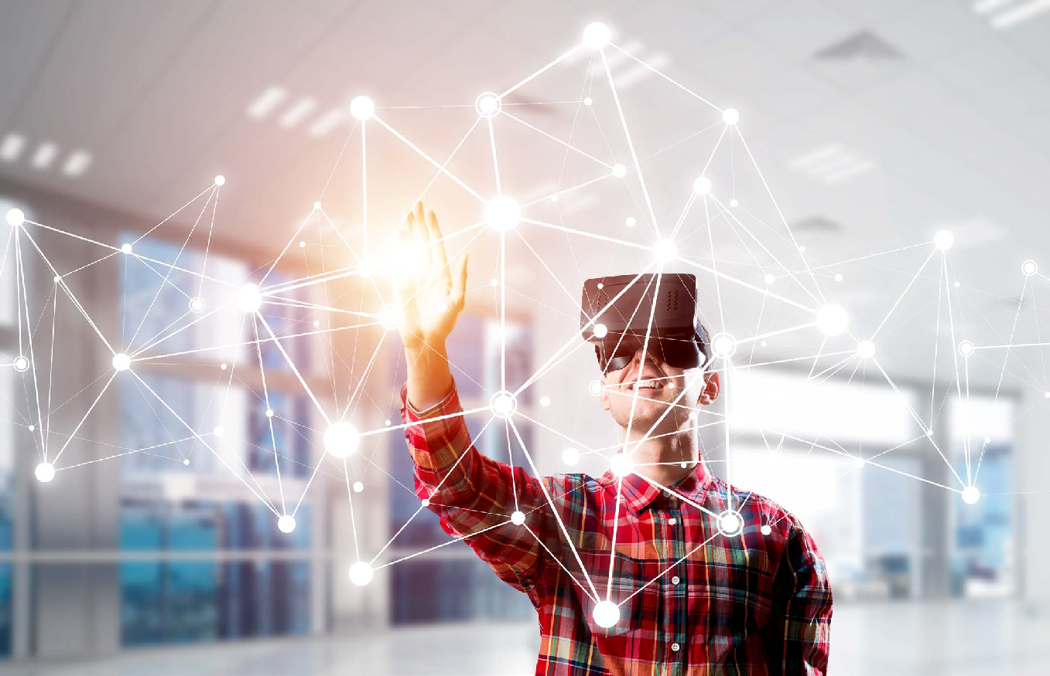
Content
A few years back, we saw the evolution of 3-D enabled Smart TVs. Most of the leading TV manufacturers marketed 3D TVs, but eventually, this feature of television could not get mass adoption and the primary reason was the availability of the CONTENT.
Apart from a few cartoon programs, there were hardly any show, movies, documentaries etc. available to watch. In the field of AR/VR also, the availability of the content is also a key challenge for wider adoption.
There are many 3-D and Virtual Reality video games available, but real-world – daily usage applications, are generally lacking. Again, most of the prototypes and POC content developed are mainly for demos.
The non-availability of the content is the number one challenge for any new technology to have mass adoption.
Power and Speed
Both AR and VR are high image processing devices and thus require a very high computing power and a very robust hardware component to operate. Additionally, these devices are supposed to be highly collaborative and connected, which would require a high-speed 5G network bandwidth available. Most of the currently used PC and desktop hardware are not capable enough to operate the AR/VR application. The exception to this is AR/VR experiences on smartphones and console devices. But other devices, like the Microsoft HoloLens, Facebook Oculus Rift, etc., require a powerful CPU/ GPU, high network and internet speed.
Additionally, most of the head-mount VR/ AR devices are now wireless, but they are high energy consumption devices, and thus require high-energy batteries for long duration operations.
The challenge of Power and Speed would require the hardware and the network carriers’ providers to upgrade their respective service lines of business. Computer machine manufacturers would be required to introduce more powerful machines capable of handling the high- performance of the AR/VR application.
Secondly, the network carrier cellular companies need to expand network spectrum to higher bands.
Security
As with the evolution of any technology, the concern around security becomes a key aspect for its stability. Right now, AR/VR is not yet mainstream, but as it becomes more widely used and rises in popularity across additional sectors beyond Gaming and Entertainment, security concerns around data and devices connectivity will be one of the prime concerns.
AR and VR are highly immersive technology, which uses the internet as their veins to transfer data/ information for delivery and gathering information. AR/VR has a capacity to constantly record information and has the ability to impose an artificial world over and above the real-physical-world which raises a very unique set of issues of data, privacy, identify-theft, freedom of speech and discrimination.
The pressure to bring the technology to market quickly will lead to overlooking the security concerns, which will be capitalized by cybercriminals in a very negative way. At the AWE 2015, IEEE Standard Association (IEEE – SA) held networking session to address this concern and try to bring the technologist and policymaker closer to each other and bridge the gap between technology and policy.

Slide 11
Key Takeaways for Adoption in Financial Services
Traditional banks and financial institutions have been awakened by the rise of FinTech and the novel way in which they have adapted technology to provide an innovative line of Product and Services to the digitally educated customer base. There has specifically been a lot of discussion about using AR/VR in the financial sector both for the internal and customer-facing engagements. The following are the key takeaways for adapting the AR/VR in the financial sector:
Adoption of VR/AR in Financial Services
Most of us are now well familiar with performing our routine work and shopping online without ever leaving the comfort of the house. There is a huge amount of discussion and debate about using AR/VR to provide banking and financial services.
For a FinTech, this would mean identifying the business use case and introducing a product/ service in line with the use of AR/VR to revolutionize the banking services which currently does not exist. In the last few years, banks have been trying to identify the use case and adopt this technology. A few of the examples include:
1. Citibank is testing the use of Microsoft HoloLens for building a virtual trading workstation
2. Commonwealth Bank of Australia has introduced an Augmented reality app for Real Estate which could help in buying a house
3. National Bank of Oman has introduced the AR app for finding ATM and/or bank branches.
Although the use of AR/VR is in the early infancy stage, these are very good use cases to test the water and identify the potentials of this technology in the sector. The technology revolution is all about providing an innovative user-experience and customer-engagement that differentiates ones from the others.
Technological Revolution
Since the meltdown of the financial sector in 2008, Banks and Financial Services providers are slow to innovate, as they were concentrating on stabilizing their loss and complying to the new regulations imposed on them by the government.
This was the period when the Digital revolution entered a new phase with the unexpected rise of the new technology like Blockchain, Artificial Intelligence, Machine Learning and Augmented/Virtual Reality. Additionally, the SMAC platform (Social, Mobile, Analytical, and Cloud) has a foundation and backbone layer of all the Digital revolution components.
Talking specifically about AR/VR, we saw the adoption and craze of Pokémon Go–a mobile phone-based AR game, which shows that there is a market for these technologies. This app is a very good example of SMAC platform adaption
Evolving Customer Base
With the growth and penetration of the mobile device and tablets market has had a tremendous influence on our daily life. Thus, it is imperative that the next generation of financial services needs to be around these devices.
Millennials spend most of their time on social networking and mobile devices, which provide nearly everything and any information at their fingertips. The Millennial expects the same level of service from the banking and financial service providers instead of the routine brick and mortar branches.

Slide 12
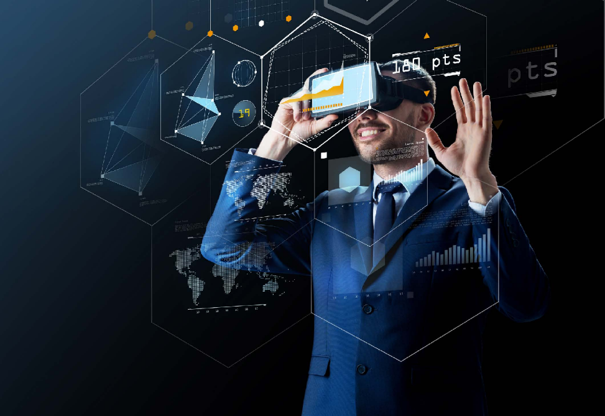
AR/VR Benefits for Financial Institutions
The new field of AR/VR is a great opportunity for traditional banking and financial institutions to incorporate as a new service line or value-added service. Financial transactions are increasingly being executed using mobile devices. Thus, providing personalized and location-based services will be a huge opportunity for the banks and financial institutions.
Specifically, regarding Retail banking products, the amount of Digital transformation which was required for Savings and Checking accounts is at its peak. Thus, banks need to look beyond Savings and Checking accounts as their innovative offerings to customers. Some of the key benefits are:
Cross-selling Opportunities
One of the best use of the AR/VR could be providing the platform for cross- selling services whic are currently not provided by the banking institutions. The Banks have all the financial transaction information - amount, shop, date, location, frequency etc. about the customer and thus provide an opportunity to cross-sell products and services.
Personalized Service Offerings
AR/VR could help banks and financial institutions provide personalized services as per the needs of the customer at the right time and locations. Based on the customer location, provide services to locate the nearest shopping mall, deals, discount coupons, ATMs and bank branches, and restaurant recommendations.
Reduce Customer Engagement Cost
As AR/VR could easily immerse in a real world, this could be useful to provide simple and non-transaction-based services which could reduce the cost of customer support. Services like finding an ATM/branches, list of service offerings, hours of operation, etc.

Slide 13
Conclusion
Augmented Reality and Virtual Reality technology are really getting ready to revolutionize our daily life in a way which we might not have envisioned it. This is a technology which is very different in bridging the gap between the real and artificial world. To harness the power of this technology in a correct way, one needs to wear the innovation cap and think differently. Talking specifically about the use of AR/VR in Banking and Financial institutions - most applications proto-typed are around performing the current work or product and services in an augmented reality environment.
Most of the financial use cases are around the Account Portfolio management, ATM and Branch Locator etc. It all looks fascinating for the first time but then one asks questions, do we really need to wear AR/VR head-mount device every time to perform these simple tasks which could be easily done in the 2D environments using laptop and mobile phone.
Maybe this is not the right way to use this technology. Maybe one need not try to forcefully fit the current line of business/services in the Augmented and Virtual environment. This could be one of the main reason why we don’t see real business use case of this technology.
Maybe the answer is to understand the capabilities of this technology and the try to identify new innovative use case which justify the use of the AR/VR technology. For any innovation to have mass- adoption- two things are important.
1. Identify a real-life problem and provide a solution to resolve it
2. Provide a new line of service which does not exist
The same could be said about AR/VR use cases. Following are some of the simple use-cases which could be thought of as justification

Slide 14
Tourism Loan Service | Live Events Streaming | Virtual Locker for Document
Banks could engage as the intermediator to cross-sell tourism package and travel loan services. Banks could collaborate with Tours and Travel companies create AR/VR Tourism Package content for the various destination. Banks could identify the customer who frequently goes on vacation and offers them an AR/VR view of the complete package of the destination. | Banks could engage with Sport streaming services to provide live streaming of sporting events, matches etc. using AR/VR. Imaging getting a 360 Degree view of the Soccer World-cup without traveling to the venue. Providing these services to a value- added customer of the bank could generate an added source of income for banks | Most bank branches provide locker facility to its customer and charge a small fee. This is good for all sort of physical items to safely keep in the locker. In today’s digital world, everyone does have a digital document, files, password, security code etc. which need to be safely kept. Banks could provide Virtual locker facility using AR/VR which could help their customer to keep the document or other digital content safely.
Cross-selling – Provides an opportunity to cross-sell product New Product/Service – Provides a cheaper credit facility to the customer for travel. An additional line of business and income | Value Added Services – Provides an opportunity to give value-added services to its customer | Value Added Services – Provides an opportunity to give value-added services to its customer. New Product/Service – Provides a cheaper credit facility to the customer for travel. An additional line of business and income

Slide 15
Thank you

